Slide 1
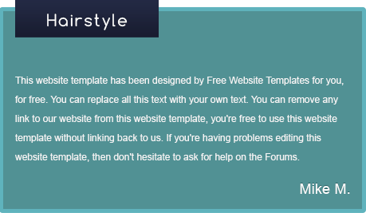
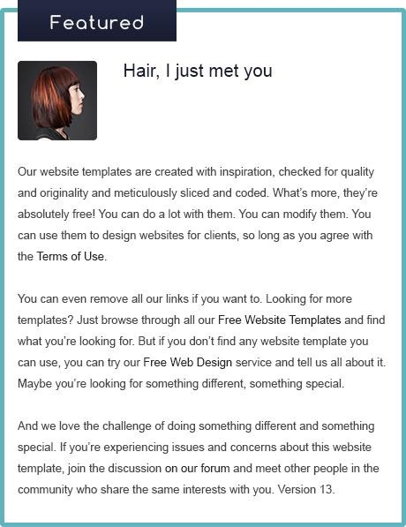
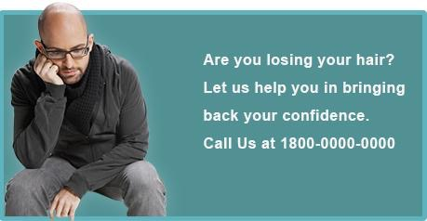




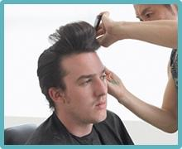
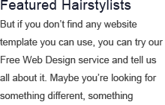
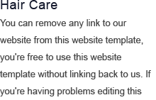
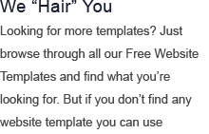
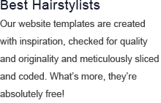

Notes:
Precedence (Guide the Eye)
Directions: Use the following 5 tools to create a layout from the given elements to guide your viewer’s eye through the important elements on a web page.
Position — Rearrange the elements on the page so the viewer sees the most important elements first.
Size — Important elements should be big to stand out from the rest.
Design Elements — Use shapes to draw the user’s eye to important elements or use shapes to group similar items on the page.
Color — Use color (on the shapes) to draw the user’s eye to important elements.
Contrast — Make sure that important elements are different and stand out from the rest of the elements.

Slide 2
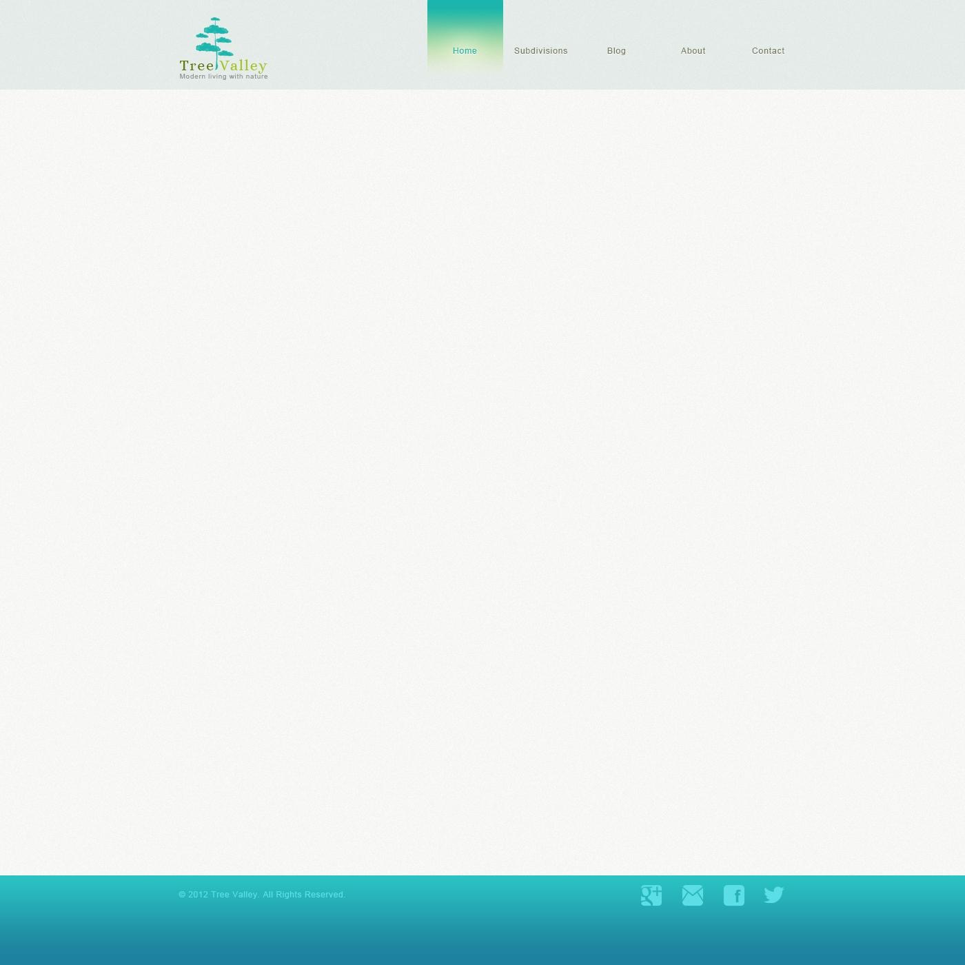
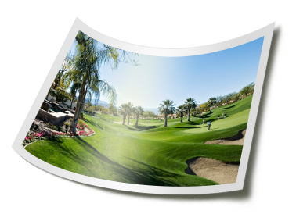

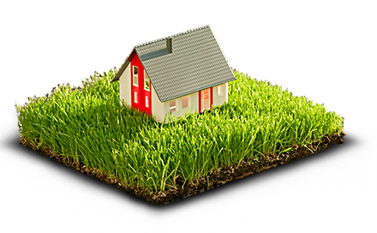

This website template has been designed by freewebsitetemplates for you, for free.
You can replace all this text with your own text. You can remove any link to our website from this website template, you're free to use this website template without linking back to us.
If you're having problems editing this website template, then don't hesitate to ask for help on the forum.
This website template has been designed by freewebsitetemplates for you, for free. You can replace all this text with your own text. You can remove any link to our website from this website template, you're free to use this website template without linking back to us. If you're having problems editing this website template, then don't hesitate to ask for help on the forum.
This website template has been designed by freewebsitetemplates for you, for free. You can replace all this text with your own text. You can remove any link to our website from this website template, you're free to use this website template without linking back to us.
If you're having problems editing this website template, then don't hesitate to ask for help on the forum.
Notes:
Spacing
Directions: Use the following 3 tools to create a layout from the given elements that is clear, organized, and easy to read.
Line Spacing
Padding
White Space

Slide 3
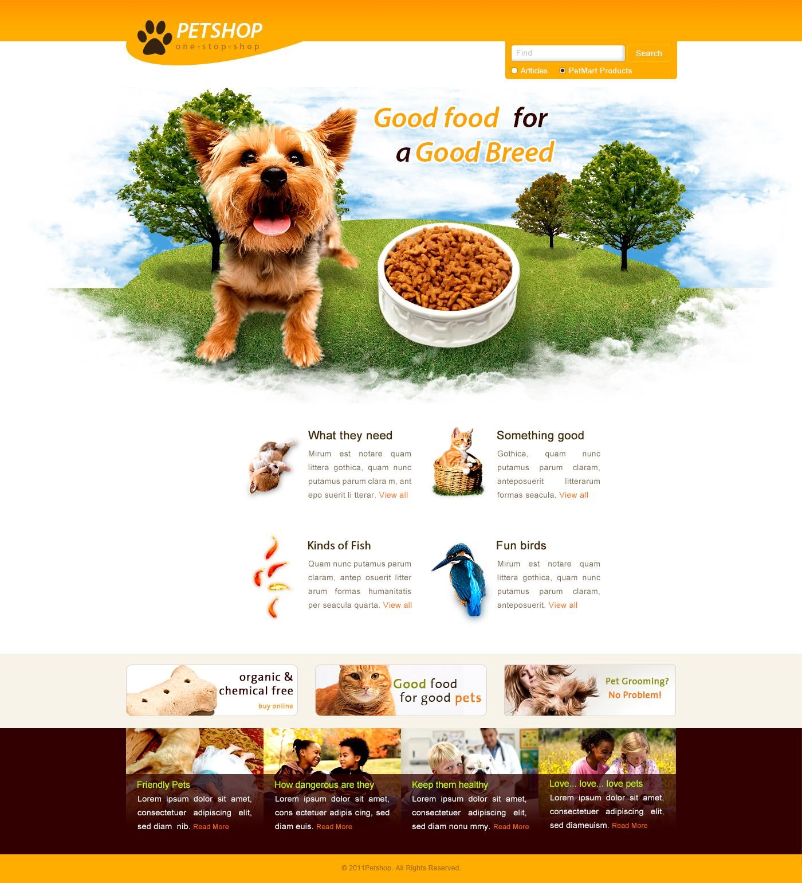
Home
PetMart
Notes:
Navigation
Directions: Use the drawing tools and text tool to design a navigation bar (horizontal or vertical) that tells the user where they are (home) and where they can go (listed below).
Home
PetMart
About Us
Blog
Pet Guide
Contact Us

Slide 4
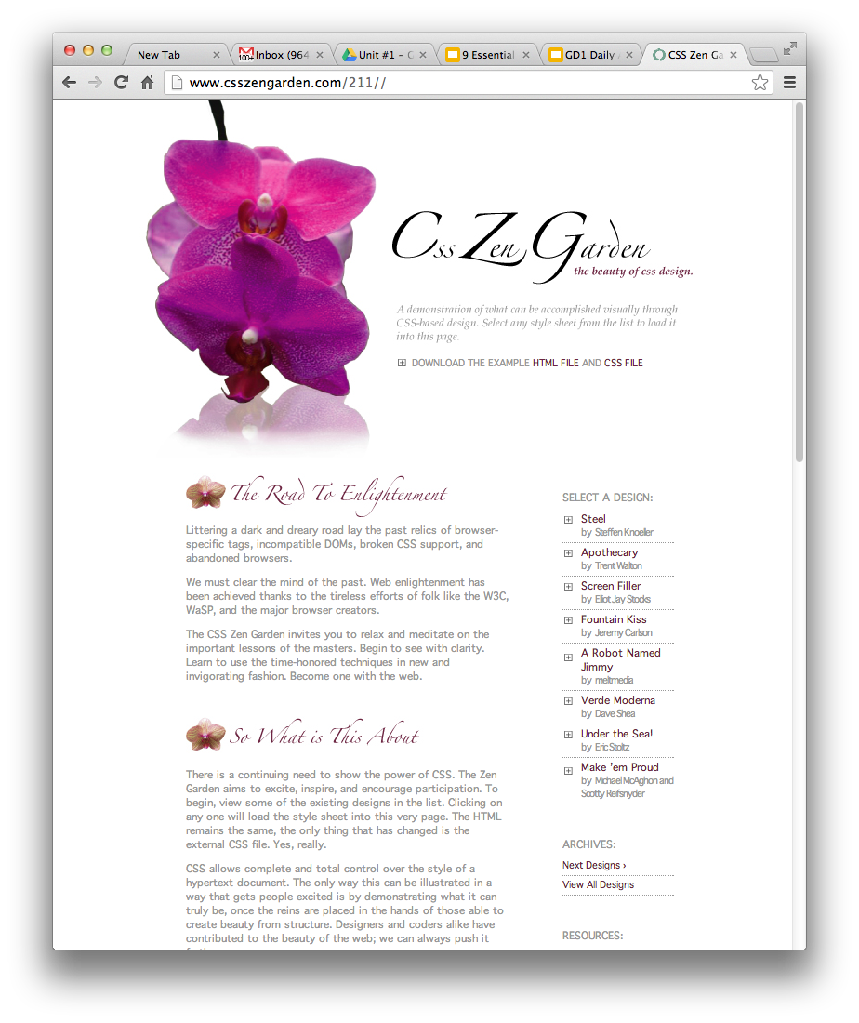
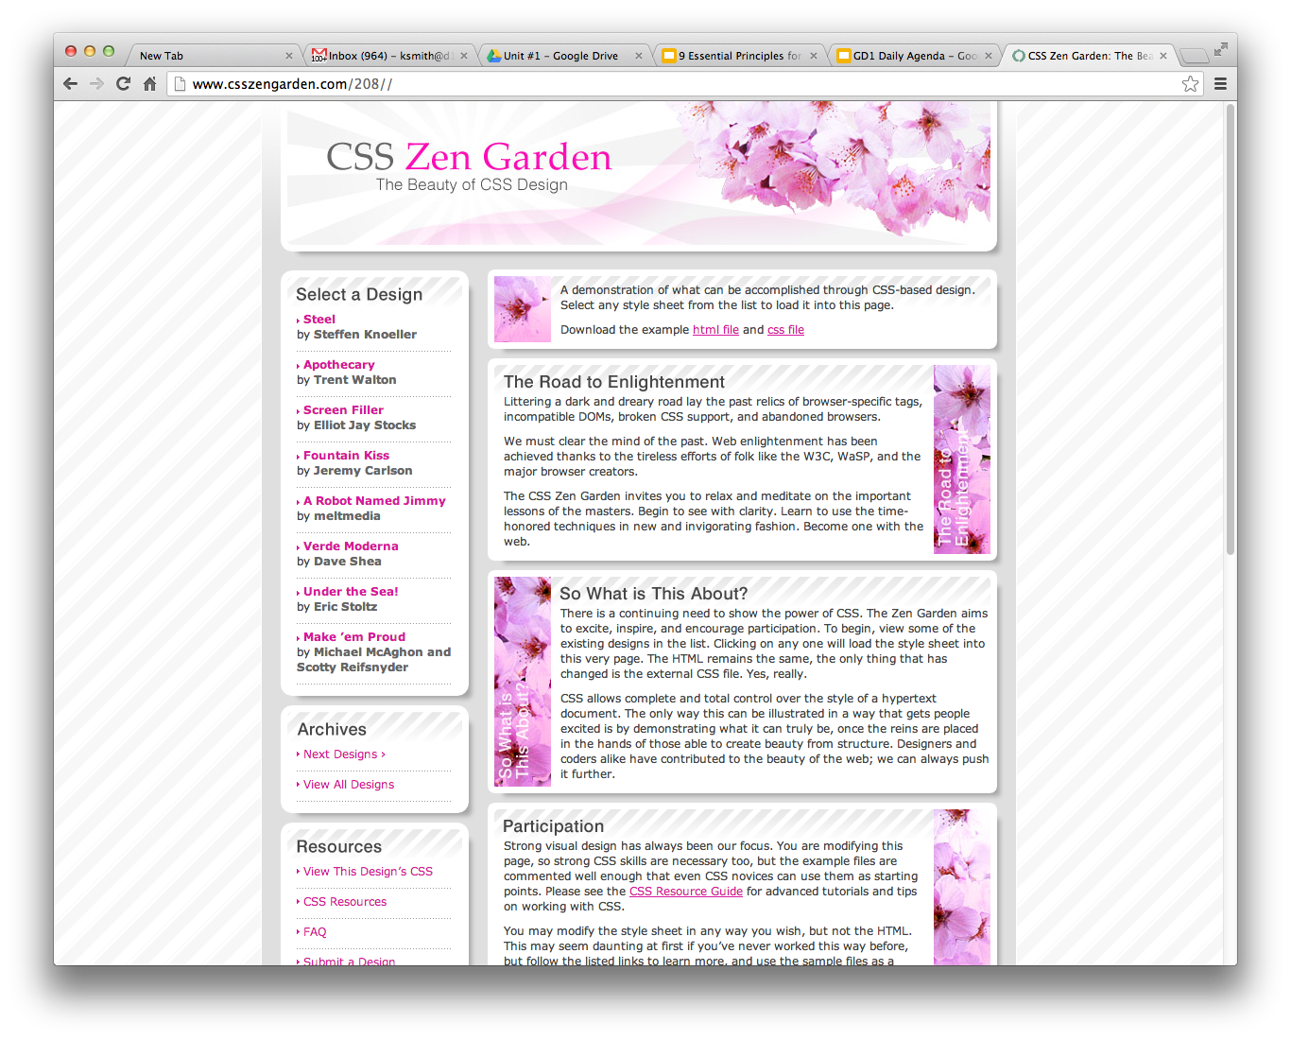
1
2
This is the same website with two different layouts. Which do you think would be easier to code/create and why? Give at least two specific reasons why one would be easier to code than the other.
The first one is likely easier as little CSS will be needed to position the layouts. It also simply scrolls up and down instead of providing a layout that positions elements in a table-like fashion. The second also looks like it will adjust based on browser width, as evidenced by the border background image.
Notes:
Design to Build
Directions: Answer the question in the text box provided.

Slide 5
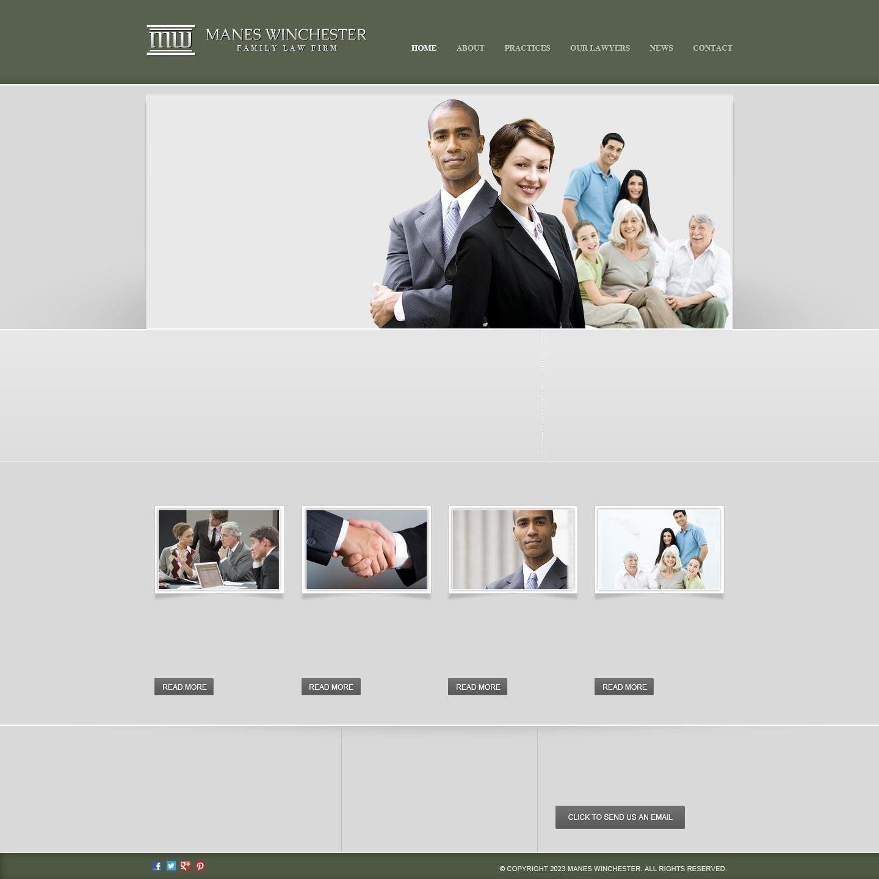
It’s never easy...
When it comes to family.
But we can set everything straight.
Testimonials
“Aenean ullamcorper purus vitae nisl tristique sollicitudin. Quisque vestibulum, erat ornare.”
-John Doe and Jane Doe
Why Choose Us?
The Manes Winchester Promise
This website template has been designed by Free Website Templates for you, for free. You can replace all this text with your own text. You can remove any link to our website from this website template, you're free to use this website template without linking back to us. If you're having problems editing this website template, then don't hesitate to ask for help on the Forums.
get to know us more
Just browse through all our Free Website Templates and ﬁnd what you’re looking for.
what we offer
Join the discussion on our forum and meet other people in the
community.
get in touch with us
And we love the challenge of doing something different and something special.
Our lawyers
Our website templates are created with inspiration, checked for quality and originality.
SEND US A MESSAGE
If you're having problems editing this website template, then don't hesitate to ask for help on the Forums.
Latest news
This website template has been designed by Free Website Templates for you, for free.You can replace all this text with your own text. You can remove any link.
Contact Us
ADDRESS: One Stevenson Drive Lincolnshire, IL 60069
PHONE: (847) 415-4000
EMAIL: info@d125.org
Notes:
Typography
Directions: Use the text formatting options to create pleasing and readable website. Consider the following when formatting the text:
Font Choice
Font size
Spacing
Line Length
Color
Alignment

Slide 6
Think about a website that you visit regularly that is frustrating to use. List at least two reasons this website is not user friendly.
Website URL: reddit.com/r/csshalp
The website is littered with an arcane layout and no “pop” to important elements. Everything is a dull blue hue and nothing really stands out when visiting the page. New users will be turned away when too much information is thrown at them.
Think about a website that you visit regularly that is easy to use. List at least two reasons this website is user friendly.
Website URL: d125.org
The site layout doesn’t provide quick ways to access information people actually care about. It instead provides a quick way to look at terrible-written event reminders. Plus half the links are broken because the website was restructured from some outsourced company.
Notes:
Web design isn’t just about pretty pictures. With so much information and interaction to be effected on a Web site, it’s important that you, the designer, provide for it all. That means making your Web site design usable.
We’ve already discussed some aspects of usability – navigation, precedence, and text. Here are three more important ones:
Adhering to Standards – There are certain things people expect, and not giving them causes confusion. For example, if text has an underline, you expect it to be a link. Doing otherwise is not good usability practice. Sure, you can break some conventions, but most of your Web site should do exactly what people expect it to do!
Think about what users will actually do – Prototyping is a common tool used in design to actually ‘try’ out a design. This is done because often when you actually use a design, you notice little things that make a big difference.
Think about user tasks – When a user comes to your site what are they actually trying to do? List out the different types of tasks people might do on a site, how they will achieve them, and how easy you want to make it for them. This might mean having really common tasks on your homepage (e.g. ‘start shopping’, ‘learn about what we do,’ etc.) or it might mean ensuring something like having a search box always easily accessible. At the end of the day, your Web design is a tool for people to use, and people don’t like using annoying tools!

Slide 7
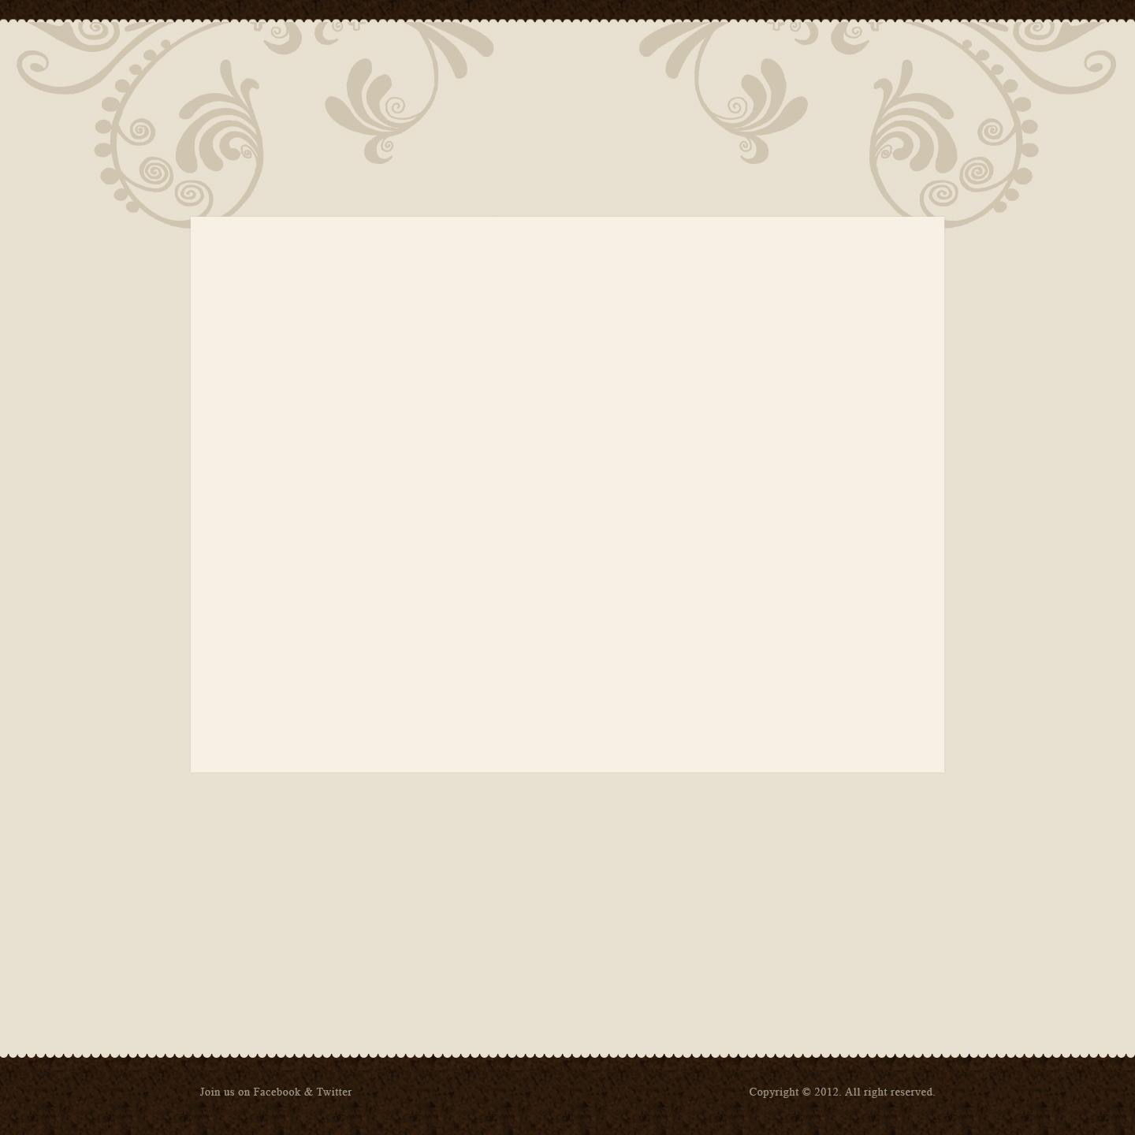


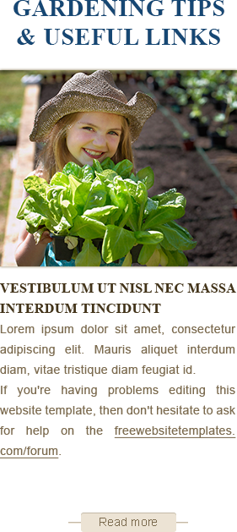
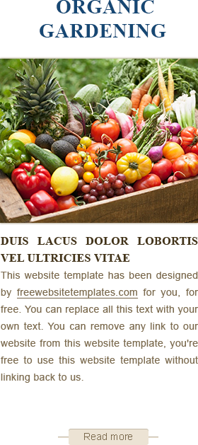
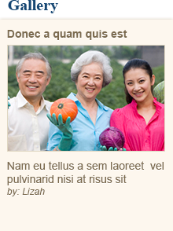

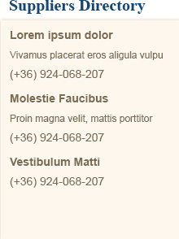
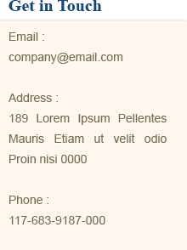
Notes:
Alignment
Directions: Rearrange the elements on the page, paying attention to alignment. Elements should be aligned to each other and the page. Elements should also be evenly spaced.

Slide 8
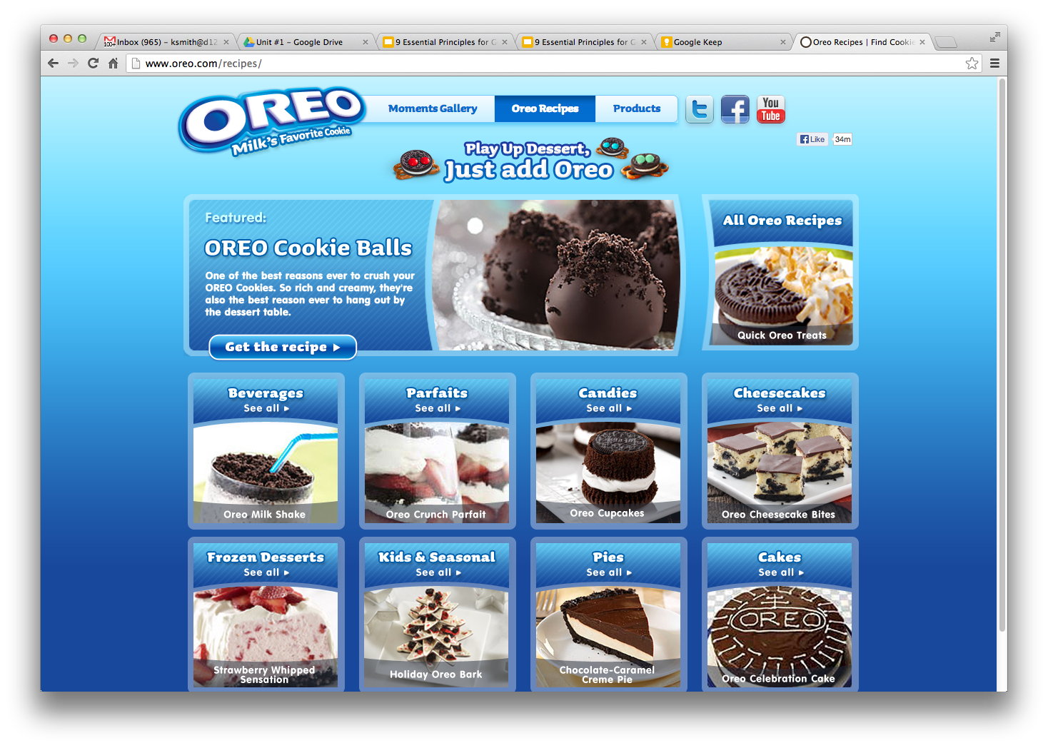
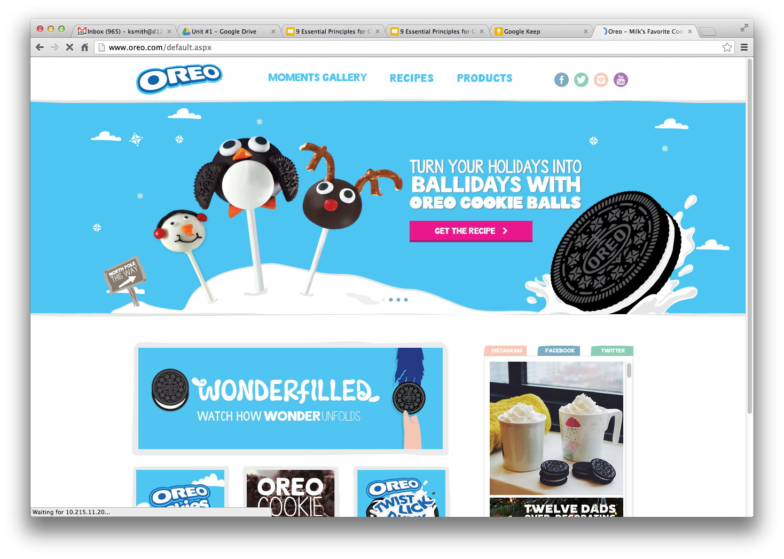
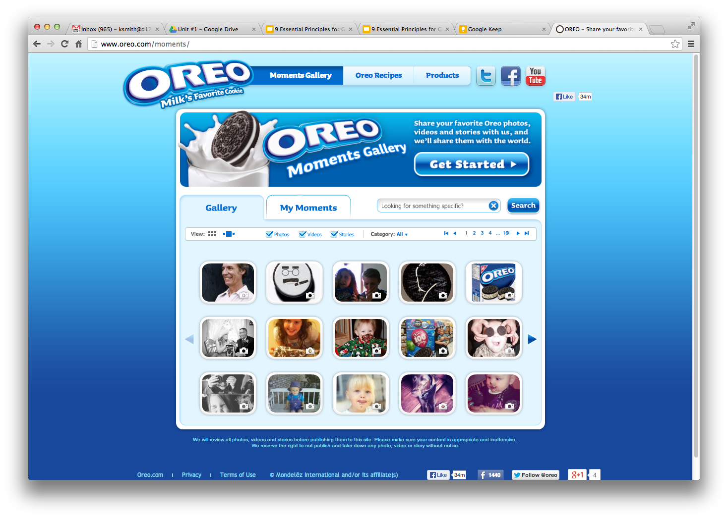
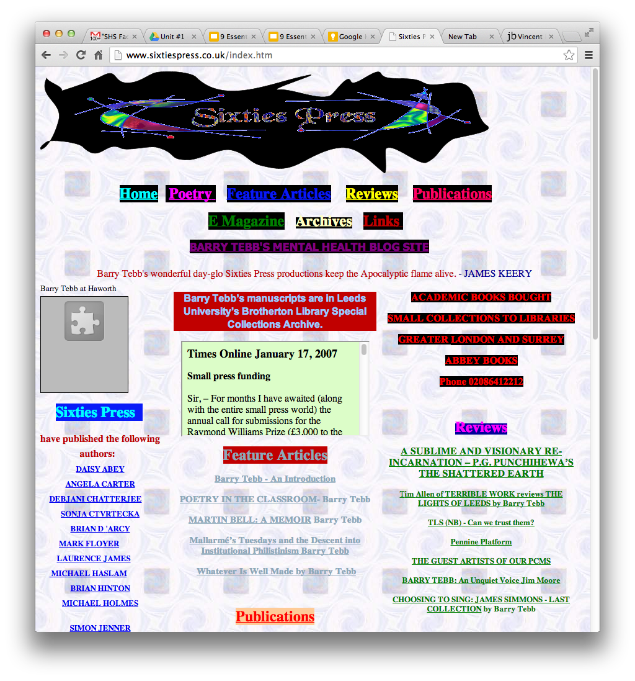
Which one doesn’t belong?
Place a over the one that doesn’t belong in each row.
List at least 5 things that make this a bad website design.
Lack of animated gifs that really add to the website
No looping “Darude - Sandstorm” in the background
Banner is left justified, it should be right justified
They’re using a Mac
The flash animation should have really loaded already
List 5 things a web designer can do to maintain consistency in a design.
Add the same looping audio to each page to maintain consistency
Use Flash for the entire page instead of just some elements
Load all Javascripts on each page instead of just the one that you need
Maximize RAM usage - after all, unused RAM is wasted RAM!
Load ALL pages at the same speed - in case one page is slow, at least all the other ones match its speed.
Notes:
Consistency
Directions: In each row, select the one that doesn’t belong. Answer the question in the text box provided.

Slide 9
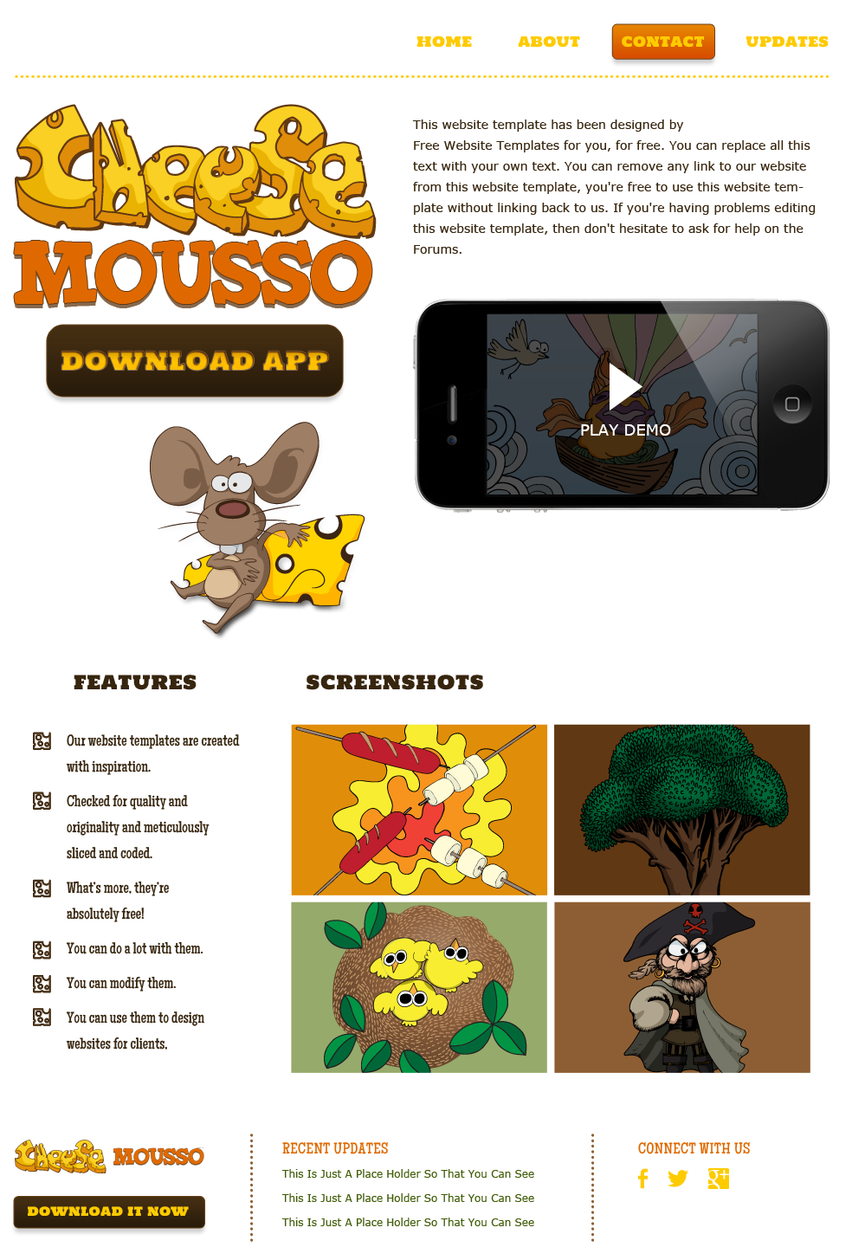
Notes:
Color
Directions: Create a color scheme for this website that complements the existing images, logo, and elements. Be sure to use shapes to section off the following areas: *Hint: Send your shapes to the back so they appear behind the website content.
Navigation
Background
Footer
Features
Screenshots

